Slide 1
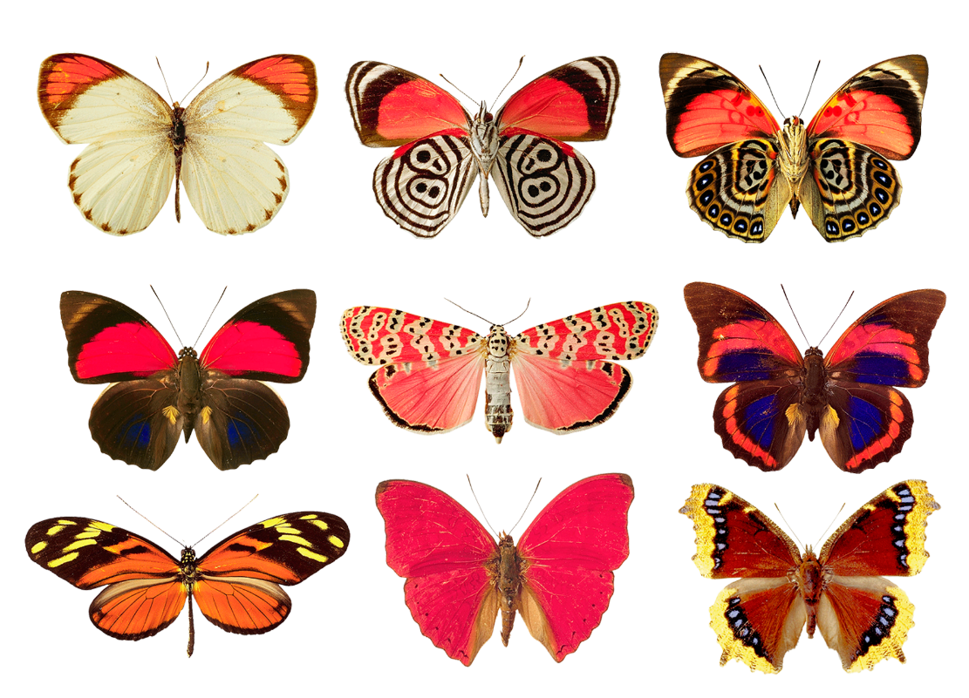
2.5 OOP Principles Part 2
academy.zariba.com

Slide 2
Lecture Content
Polymorphism
Cohesion
Coupling

Slide 3
Fundamental Principles of OOP
Inheritance
Inherit members from parent class
Abstraction
Define and execute abstract actions
Encapsulation
Hide the internals of a class
Polymorphism
Access a class through its parent interface

Slide 4

1. Polymorphism
Polymorphism is the ability to take more than one form – a derived class can be used through its parent interface
Derived classes can override some of the behaviour of the parent class
Polymorphism allows abstract operations to be defined and invoked. It also allows you to mix related types in the same collection

Slide 5
2. Cohesion
Cohesion describes how closely routines in a class/method or generally in the code support a central purpose
Cohesion must be strong – classes must contain strongly related functionality and aim for a single purpose
e.g. The Math class, DateTime class
e.g. A class which creates all characters, draws them, moves them, starts the game…

Slide 6
3. Coupling
Coupling describes how tightly a class/method/routine is related to other classes or routines
Coupling must be loose – there should be little or no dependency between classes
If there is dependency it should be clearly stated

Slide 7
Summary
OOP fundamental principles are: inheritance, encapsulation, abstraction, polymorphism
Inheritance allows inheriting members from a base class
Abstraction and encapsulation hide internal data and allow working through more abstract interfaces
Polymorphism allows working with objects through their parent interface and invoke abstract actions
Use strong cohesion and loose coupling to avoid spaghetti code

Slide 8
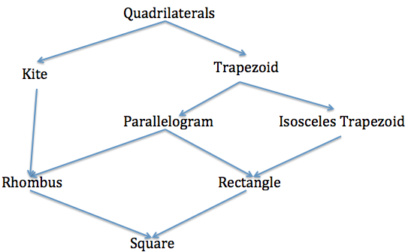
Homework
1. Design an application which calculates the surface and perimeter of different shapes: circle, triangle, square, rectangle, trapezium, rhombus and a regular n-gon. Make an abstract class Shape which will hold 2 methods (calculate area and perimeter) and a single attribute value. Be very careful when using inheritance and abstraction – all common features of each shape should be inherited from the base shape. The picture below could be useful (or not). If you can calculate the area using the sides only, you should do that. Otherwise, define all necessary additional fields you may need like angles, heights and so on. Test your application with all possible shapes, stored in a list, and print their area and perimeter.

Slide 9

References

Slide 10



Zariba Academy
Questions

